Slide 1
DATA STRUCTURES LABORATORY
Lab Session 12 (Binary tree and perform tree traversal)

Slide 2
Session No. | Programs | Page No.
1 | To find the length of a string To concatenate two strings To copy a string to another string To reverse a string
2 | To generate “n” terms of the Fibonacci series To find the GCD of two numbers
3 | To insert an element at a given position in an array To delete an element from a given position in an array To perform Bubble sort
4 | To perform Insertion sort To perform Selection sort
5 | To perform Linear search To perform Binary search
6 | To perform stack operations
7 | To perform Queue operations
8 | To perform circular Queue operations
9 | To convert Infix expression to Postfix expression
10 | Insertion of elements to a linked list
11 | Deletion of elements from a linked list
12 | To create a binary tree and perform tree traversal

Slide 3
Traversal is a technique for visiting all of a tree's nodes and printing their values. Traversing a tree involves iterating over all nodes in some manner. We always start from the root (head) node since all nodes are connected by edges (links). As the tree is not a linear data structure, there can be more than one possible next node from a given node, so some nodes must be deferred, i.e., stored in some way for later visiting.
Types of Traversal of Binary Tree
There are three types of traversal of a binary tree.
Inorder tree traversal
Preorder tree traversal
Postorder tree traversal

Slide 4
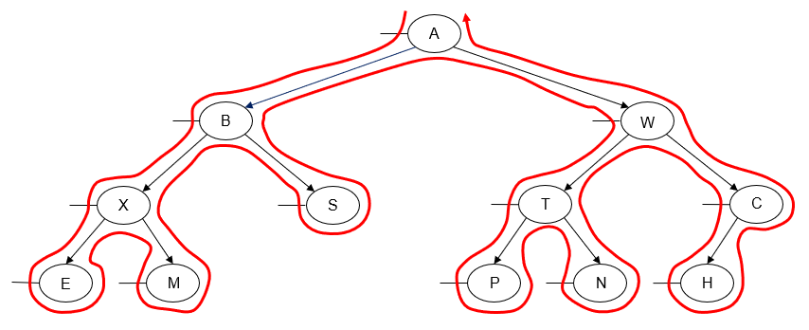
Preorder Traversal
In a preorder traversal of a binary tree, we "visit" a node and then traverse both of its subtrees. Usually, we traverse the node's left subtree first and then traverse the node's right subtree.
Here's an example of a left-to-right preorder traversal of a binary tree:
Printing the value of each node as we "visit" it, we get the following output:
A B X E M S W T P N C H

Slide 5
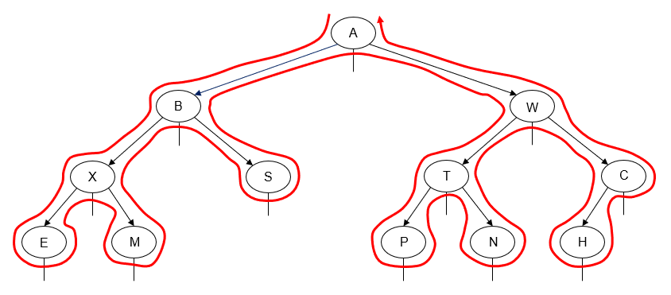
Inorder Traversal
In an inorder traversal of a binary tree, we traverse one subtree of a node, then "visit" the node, and then traverse its other subtree. Usually, we traverse the node's left subtree first and then traverse the node's right subtree.
Here's an example of a left-to-right inorder traversal of a binary tree:
Printing the value of each node as we "visit" it, we get the following output:
E X M B S A P T N W H C

Slide 6
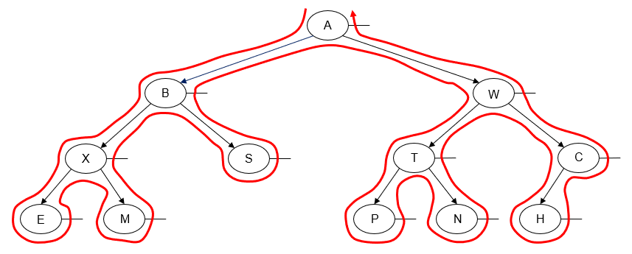
Postorder Traversal
In a postorder traversal of a binary tree, we traverse both subtrees of a node, then "visit" the node. Usually we traverse the node's left subtree first and then traverse the node's right subtree.
Here's an example of a left-to-right postorder traversal of a binary tree:
Printing the value of each node as we "visit" it, we get the following output:
E M X S B P N T H C W A

Slide 7
